Slide 1
10th & 11th Grade Parent Resource Night
*New Graduation Requirements
*College & Career Readiness Assessment
*Planning Resources

Slide 2
New Graduation Requirements (Say What??)
Credit Requirements Remain The Same
College & Career Readiness Assessment Handout
Students will be required to take 1 of 3 assessments
ACT
SAT
WorkKeys

Slide 3
What is DHS doing to assist students & parents?
Holding parent night
Mailing resources home
Posting information on social media
Aligning MAP data with ACT predictive scoring
Partnering with Ft. Greely Child, Youth and School Services

Slide 4
What does ASVAB, MAP, AMP, PSAT, ACT, SAT mean?

Slide 5
How do I know which test to take?
MindMeister
Additional information about tests
Students will fill out this form to distinguish which test they will take “during the school day”
REMEMBER!!!!
The State of Alaska will only allow a student to take one of three of the assessments for free!

Slide 6
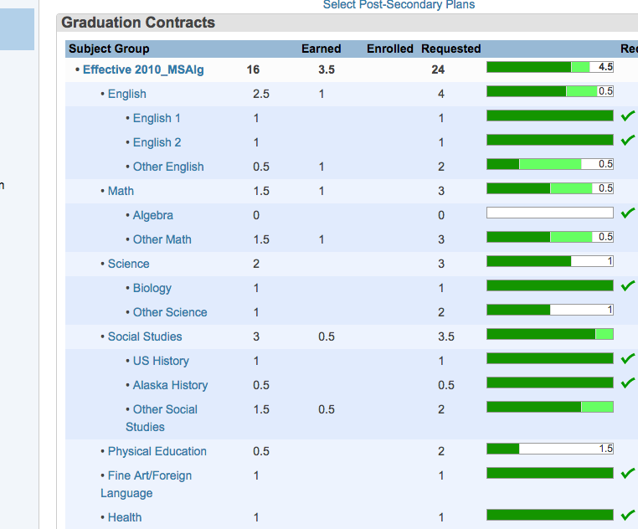
View Graduation Progress in PowerSchool
Grades History Tab
Why should you check?
Check progress towards graduation
Ensure taking right curriculum for Alaska Performance Scholarship

Slide 7
Alaska Career Information System Planning Tools
A comprehensive planning tool your child already uses
Course planner for class registration
College and career resources
Scholarship search
www.akcis.org
U:deltagreely or Powerschool Login
4Student or Reset Password

